Slide 1



Street Ball League
Signup
Name
Email
Password
SIGNUP
Login
Email
Password
LOGIN
?

Slide 2


Street Ball League
Memphis 2025
Season ends 29th November
Morant
Grizzlies
Pickup
coming
soon
Solo
AS
87dp
Team
coming
soon
Schedule
Street
Ball
YOU
vs SC30
Victory
27-19
Hoop
Royale
Hibiscus
Stadium
Tomorrow
Meetup
Rochedale
29th Nov
9:00am
PLAY
?

Slide 3
Create
Create a lobby or join an existing one!
CREATE
JOIN
?

Slide 4
Create
Select game mode!
SOLO
TEAM
FILL
?

Slide 5

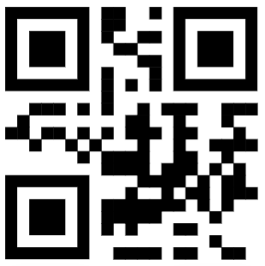


Lobby
Ja Morant
D1 10dp waiting
100K
Steph Curry
D1 78dp waiting
Rules
No deviations from SBL rule book.
W+26 L-24
893421
READY
?

Slide 6
Lobby
Ja Morant
D1 10dp waiting
100K
Steph Curry
D1 78dp waiting
893421
Game Rules
No deviations from SBL rule book.
W+26 L-24
READY
?

Slide 7

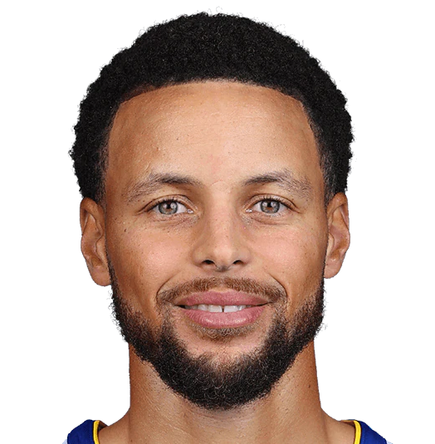

Hoop Royale
Swiss Solos
2025.1 .
$500 Prize Pool
.
Saturday 10am – 8pm
Round 2
Victory
43 : 38
You
2:0
Morant
1:1
BRACKET
REGISTER
?

